Slide 1
LEGAL SHIELD AI – AI Powered Cyber Crime Detection & Legal Assistant

Slide 2
Problem Statement
Cyber crimes such as phishing, fraud and blackmail are increasing.
Victims often lack awareness about cyber laws.

Slide 3
Cybercrime Challenges
Lack of awareness
Slow complaint process
Difficulty identifying scams
Limited legal guidance

Slide 4
Proposed Solution
LEGAL SHIELD AI detects cyber threats and provides legal guidance with automated complaint generation.

Slide 5
Key Features
AI Scam Detection
AI Legal Advisor
Evidence Analyzer
Automatic Complaint Generator

Slide 6
Technology Stack
Frontend: HTML CSS JS
Backend: Python Flask
AI: Generative AI + NLP
Database: MongoDB / Firebase

Slide 7
System Workflow
User Uploads Evidence
AI Threat Analysis
Identify Cyber Law
Generate Complaint
Provide Guidance

Slide 8
System Architecture
Frontend HTML CSS JS
Backend API Python Flask
User
AI Engine Generative AI + NLP
Legal Knowledge Base
Threat Detection
Output Advice + Complaint

Slide 9
User Interface Overview
Main UI screens of the platform

Slide 10
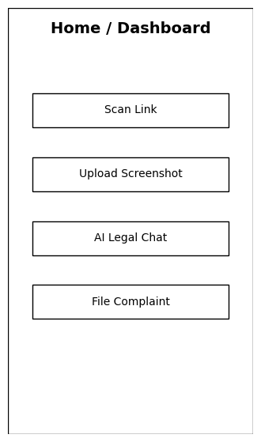
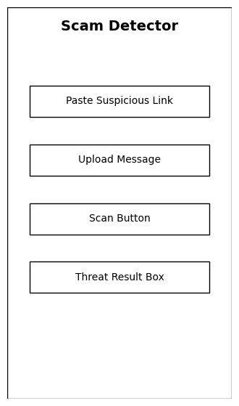
Home Dashboard
SCAM DETECTOR

Slide 11
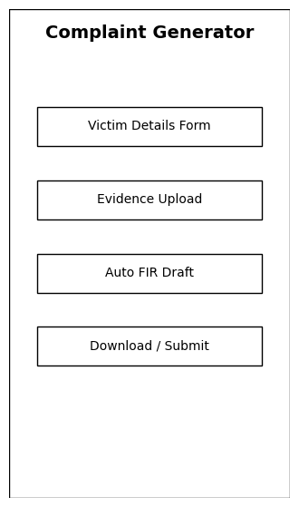
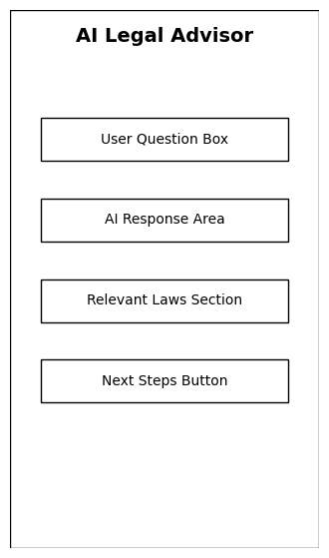
AI Legal Advisor
COMPLAINT
GENERATOR

Slide 12
Innovation & Competitive Advantage
Combines Cybersecurity + Generative AI + Legal Assistance
Automated complaint generation
User‑friendly interface for victims
Bridges gap between cybercrime detection and legal awareness

Slide 13
Future Scope
Integration with Cyber Crime Portal
Mobile App
Real‑time scam alerts
Multilingual legal guidance

Slide 14
Conclusion
LEGAL SHIELD AI helps citizens detect scams, understand cyber laws and report crimes quickly.

Slide 15
Team Name: Shadow
Team Members
Rushikesh Jadhao
Piyush Raj
Hrijiscrita Baruah

Slide 16
Team Roles
Rushikesh Jadhao – Backend + NLP
Piyush Raj – Frontend + Generative AI
Hrijiscrita Baruah – Database

